Slide 1
Energy in Electrical Systems
Outline
Review of Last time
Electric Fields and Work
Conservation Laws
      Kirchhoff’s Voltage Law
      Kirchhoff’s Current Law
      Energy in Capacitors, Batteries and Molecules

Slide 2



TRUE or FALSE?
In steady state operation of a motor, all of the energy that goes in is lost to heat due to friction.
In a motor, the back EMF is proportional to the frequency of rotation.
Gauss’ Law states that

Slide 3
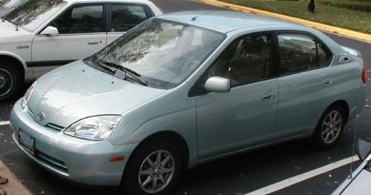
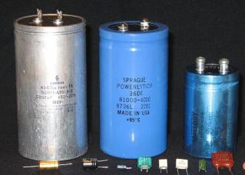
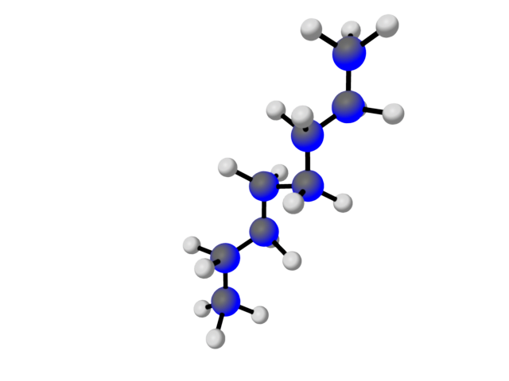
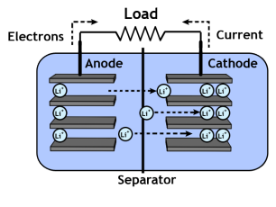
Today
we will consider
different methods of
Energy Storage in
Hybrid Vehicles
to solve the “mystery” of why gasoline is so efficient in storing energy
Image is in the public domain
Capacitor
Battery
Gasoline
Prius NiMH: 1.8 kW-h
1 gallon : 40 kW-h
: 52 kg
: 2.75 kg
Image is in the public domain

Slide 4

A REVIEW OF YESTERDAY’S LECTURE
When motor turns it generates “Back EMF”
The 1st Law requires that any contraption that can be used as an electromechanical actuator can use its actuation to generate EM fields:
- a motor can also be used as a generator.
- a loudspeaker can also be used as a microphone
Torque of a motor = motor constant × motor current
When frictional torque in a motor equals the morque from the Lorentz force inside the motor, the net torque is zero and a steady operation is achieved.
Frictional Torque = constant × angular velocity
Operated at CONSTANT CURRENT – motors have steady torque
Operated at CONSTANT VOLTAGE – motors have steady angular velocity
Energy stored in 1 gallons of gasoline is 35 kW-hr (or rounding-up 40 kW-hr)
Electric vehicles are more economical per mile traveled, however, they can travel fewer miles since the batteries store less energy per kg than fuel does

Slide 5
Hypothetical Gas-Powered Go-Cart:
Let’s make a comparison to a similar go-cart powered by a reasonably sized gasoline engine and gas tank. Let’s replace the 36 pounds of batteries by a gas tank that holds
36 pounds of gasoline.
- Gasoline weighs 6 pounds per gallon,
- Gasoline stores 40,000 Watt-hours of heat energy per gallon. That is, if you
burned a gallon of gasoline, you would get 40,000 Watt-hours worth of heat.
How many joules are stored in a gallon
of gasoline? 144,000,000 J
How many gallons of gas are stored in the
hypothetical go-cart gas tank? 6 gallons
How many joules of heat energy are stored in
the go-cart gas tank? 864 MJ
In comparison, the battery stores 2.2 MJ

Slide 6

Main Question for Today
Why does gasoline have such a large energy density
Gasoline
1 gallon : 40 kW-h
: 2.75 kg
How does E&M help me?

Slide 7






Energy and Electric Fields
E
q
Can define electrostatic potential (potential energy of a positive test charge) …
Potential changes by
a certain amount (measured in Volts) over certain distance (measured in meters)
independent of path
For “conservative” fields like in the electrostatic system,
the work done by does not depend on the path taken !

Slide 8

Energy Conservation and Conversion
Consider the following circuit:
1
2
+
-
+
-
v₁
path C
v₂
+
-
C
V
Ref = GND
For a closed loop (C), a=b so the energy expended in moving charge is zero…
Voltage drops around a closed loop (circuit) must sum to zero..
      Kirchhoff’s Voltage Law (KVL)

Slide 9

Regenerative Brakes
Hybrid cars:
Energy from regenerative braking is stored in banks of capacitors or the battery.
Bicycling along
with kinetic energy
2. Brake going up
ramp. Kinetic energy
stored as potential
energy.
3. Roll down ramp to
convert stored potential
energy back to kinetic
energy!
Image is in the public domain

Slide 10
Example of KVL: Capacitor in Series with a Resistor
The stored energy in regenerative brakes of a hybrid-car (represented as capacitor)
can power a motor load (represented as resistor)
A
B
C
D
E
F=A
POTENTIAL [V]
KVL is a statement of Conservation of Energy!

Slide 11


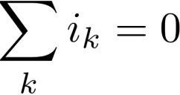

      Kirchhoff’s Current Law (KCL)
Summed over
all currents
entering a node
KCL is a statement of Conservation of Mass !

Slide 12
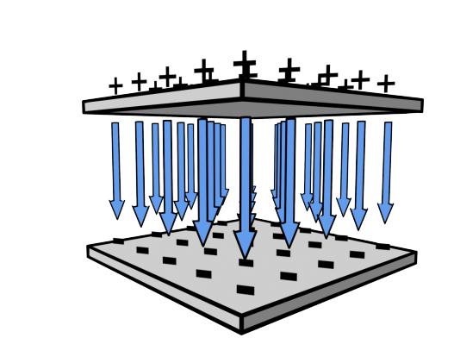

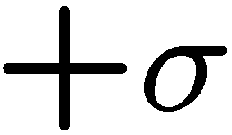








Energy Stored in Capacitors
(we will assume that the structure is mechanically rigid)
i
+
v
-
C
εA
How do we increase the energy storage?
C =
d

Slide 13
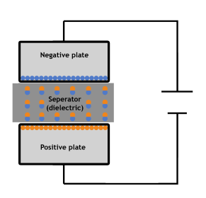
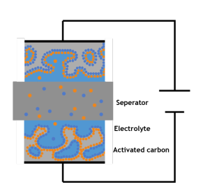
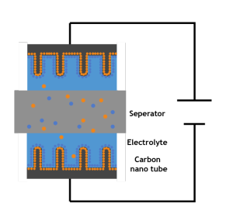
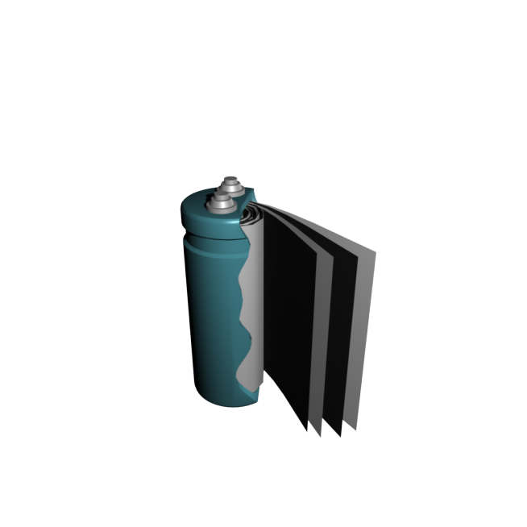
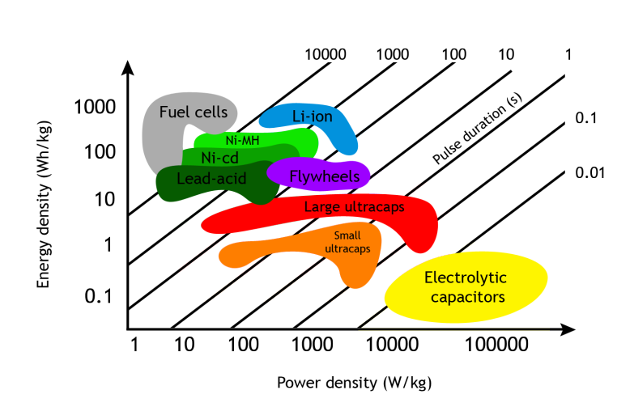
Ultracapacitors
Ultracapacitor with
carbon nanotubes
Traditional capacitor
Ultracapacitor

Slide 14


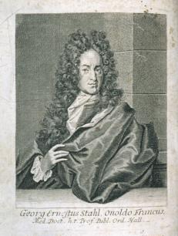

Today’s Culture Moment
Phlogiston
The “element” that was heat itself. This idea was perpetuated by Georg Stahl and was widespread in use by scientists in the 1700s.
Phlogiston
Georg Stahl
“The remarkable thing about this amazing theory was that it seemed to have worked, and it had been used by eminent and respected early scientists for an entire century before it was finally proven wrong….Phlogiston theory was perhaps the most persistent, widespread, and totally wrong mistake made by scientists all through the age when science, as we know it today, was developed.”
Fawcett, 100 Mistakes that Changed History
© Penguin Group USA. All rights reserved. This content is excluded from our Creative Commons license. For more information, see http://ocw.mit.edu/fairuse.
All images are in Public Domain

Slide 15
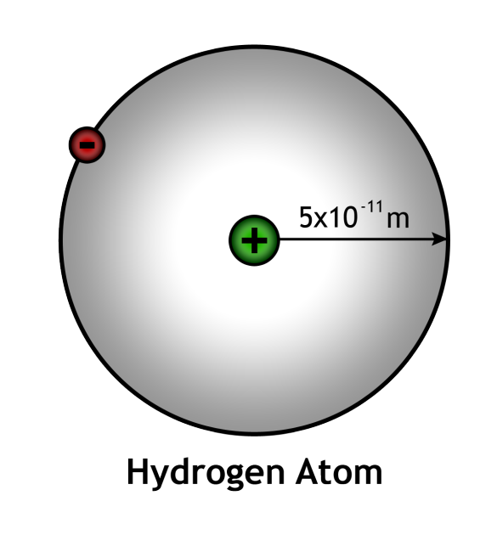
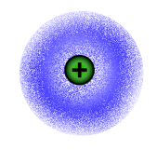
Atomic Capacitors
electron cloud
Lets approximate the electron cloud as a spherical shell of charge (-q) surrounding a positive nucleus (+q) …
… and try to estimate the capacitance, voltage, and energy …

Slide 16

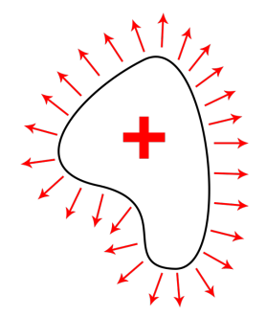
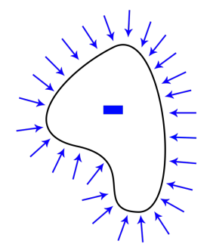


Gauss’s Law
Flux of through closed surface S = net charge inside V

Slide 17
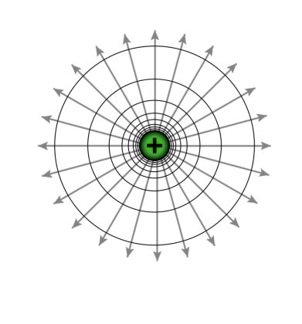



Atomic Capacitor
Field from a point charge
Area integral gives a measure of the net charge enclosed; Divergence of the electric field gives the density of the sources.
(~ 1000 kW-hr per kg)

Slide 18
Atomic Capacitor
Stored energy for atomic hydrogen…
Remember this unit of energy:
1 eV = 1.6 x 10⁻¹⁹ J
W ≈ ½ q v ≈ 14.4 eV ~ 1000 kW-hr/kg

Slide 19

1.54 Å
0.96 Å
1.16 Å
H H
H - C – C – H
H H
O
H H
- -
- -
-
-
O = C = O
1.10 Å
ENERGY OF AN ELECTRON IN AN ALCANE MOLECULE IN GASOLINE
Energy [eV]
ENERGY OF AN ELECTRON IN H₂O or CO₂
0 V
_
Hydrogen ground state energy is -13.6 eV
If the hydrogen radius was twice as long, what would be the ground state energy ?
ENERGY GIVEN OFF AS HEAT IN THE PROCESS OF GASOLINE COMBUSTION
+
_
+
Remember this unit of energy:
1 eV = 1.6 x 10⁻¹⁹ J

Slide 20
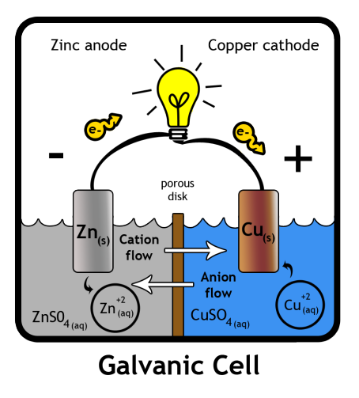
Batteries
In 1780, Luigi Galvani discovered that when two different metals (copper and zinc for example) were connected together and then both touched to different parts of a nerve of a frog leg at the same time, they made the leg contract. He called this "animal electricity". The Voltaic pile invented by Alessandro Volta in the 1800s is similar to the galvanic cell. These discoveries paved the way for electrical batteries.
Capacity of Batteries:
AAA – 1250 mAh
AA – 2850 mAh
C – 8350 mAh
D – 20500 mAh
iPhone – 1400 mAh @3.7V
From Wikipedia article on the Galvanic cell.
The more electrolyte and electrode material there is in the cell, the greater the capacity of the cell. Thus a small cell has less capacity than a larger cell, given the same chemistry
(e.g. alkaline cells), though they develop the same open-circuit voltage.

Slide 21
Energy-to-Weight Ratio
FUELS
Hydrogen 79,000 W-hr/kg
Gasoline 13,000 W-hr/kg
ELECTROCHEMICAL CELLS
Nickel-Metal Hydride 30~80 W-hr/kg
Nickel-Iron 50 W-hr/kg
Lead-Acid 30 W-hr/kg
ATOMIC WEIGHTS:
H₂ – 2 g/mol
O₂ – 32 g/mol
S – 32 g/mol
C – 12 g/mol
Cu – 64 g/mol
Zn – 65 g/mol
Pb – 207 g/mol
DIFFERENCES ARE DUE TO THE RELATIVE MOLECULAR WEIGHTS OF CONSTITUENT MATERIALS
AND A NEED FOR MECHANICAL STRUCTURE THAT SUPPORTS THE ELECTROCHEMICAL CELLS

Slide 22
Today
we will consider
different methods of
Energy Storage in
Hybrid Vehicles
to solve the “mystery” of why gasoline is so efficient in storing energy
Image is in the public domain
Capacitor
Battery
Gasoline
Prius NiMH: 1.8 kW-h
1 gallon : 40 kW-h
: 52 kg
: 2.75 kg
Image is in the public domain

Slide 23
TRUE or FALSE?
In steady state operation of a motor, all of the energy that goes in is lost to heat due to friction.
In a motor, the back EMF is proportional to the frequency of rotation.
Gauss’ Law states that
F
T
F

Slide 24
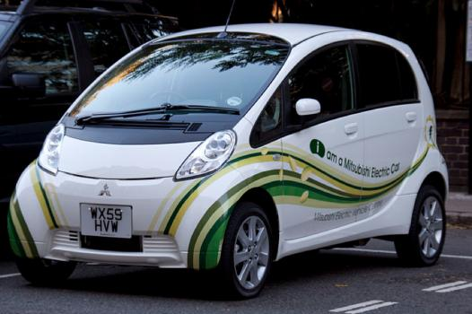
Summary
Conservation Laws
Kirchhoff’s Voltage Law
Kirchhoff’s Current Law
Energy in capacitors, batteries, and gasoline:
DIFFERENCES ARE DUE TO THE RELATIVE MOLECULAR WEIGHTS OF CONSTITUENT MATERIALS AND A NEED FOR MECHANICAL STRUCTURE THAT SUPPORTS THE ELECTROCHEMICAL CELLS
Image by Tony Hisgett http://www.flickr.com/photos/hisgett/5126927680/ on flickr

Slide 25





Extra Example: Power from Stored Electrostatic Energy
Electrical power expended in moving charge from a to b…
For electrical quasistatic systems, EQS, (slowly varying E-fields)..
Exactly what you were expecting !

Slide 26
MIT OpenCourseWare
http://ocw.mit.edu
6.007 Electromagnetic Energy: From Motors to Lasers
Spring 2011
For information about citing these materials or our Terms of Use, visit: http://ocw.mit.edu/terms.

